Slide 1
Heart Attack Analysis & Prediction

Slide 2
Table of Contents
Problem statement
Data Description
Key findings
Model Comparison

Slide 3
Problem Statement and Motivation
Design and Implement the Heart Attack Prediction and Detection System using machine learning techniques.
Heart Attack is one of the huge health risks for human’s healthy life. big data growth in medical and healthcare association today, early solution and accurate analysis of medical data benefits through patient care and community services.

Slide 4
Data Description
The dataset is extracted from Kaggle
Dataset link : https://www.kaggle.com/datasets/rashikrahmanpritom/heart-attack-analysis-prediction-dataset/code
Heart Attack Analysis & Prediction Dataset classification
The volume of the dataset is 303 samples and 14features.
There are 8 categorical variables and 5 continuous variables.
Variables :age, sex, cp, trtbps, chol, fbs, restecg, thalachh, exng, oldpeak, slp, caa, thall, output .
To predict if a person is vulnerable to heart attack or not

Slide 5
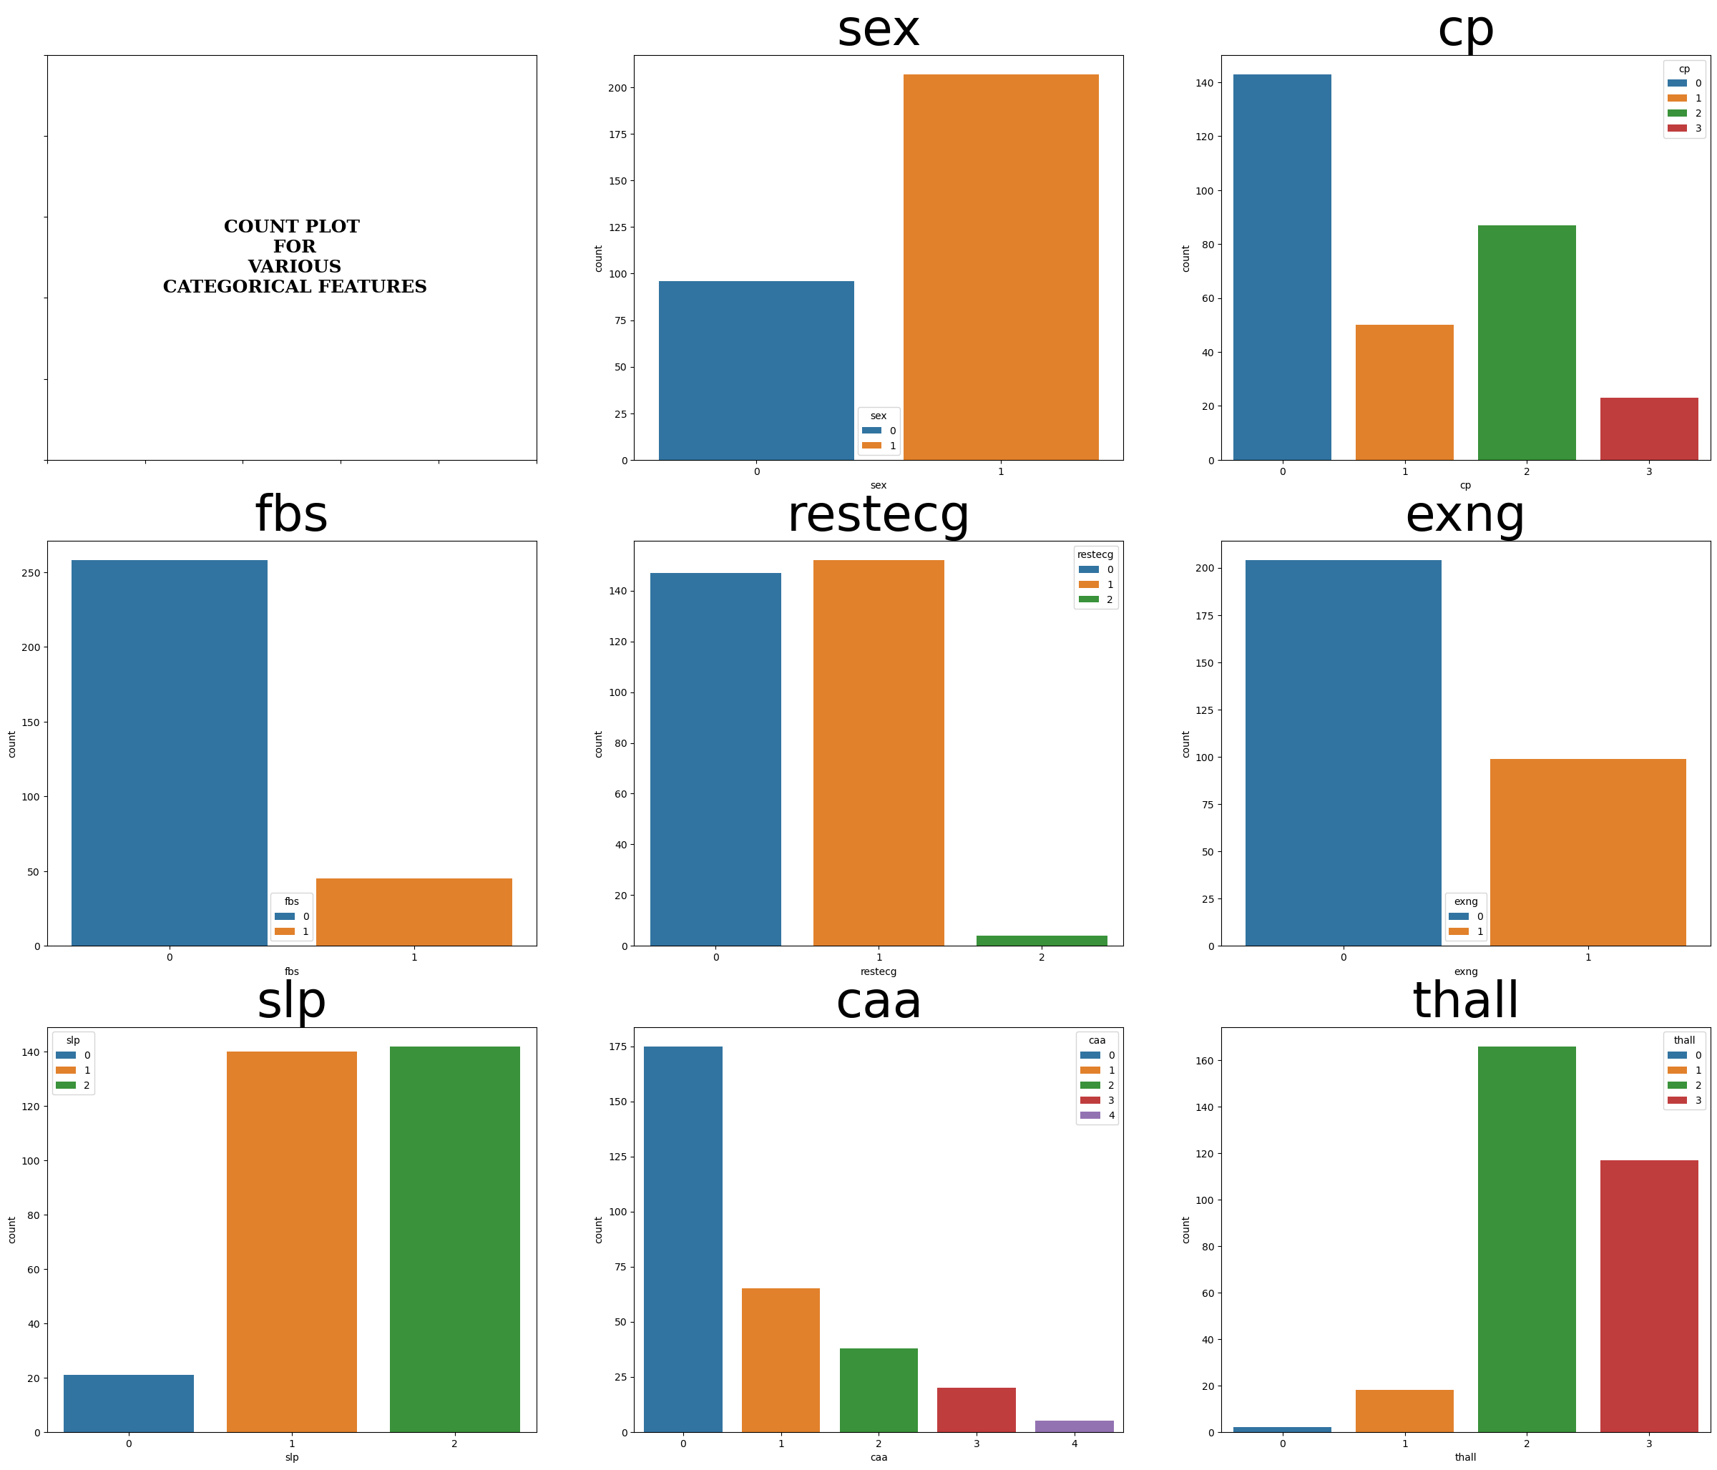

Slide 6
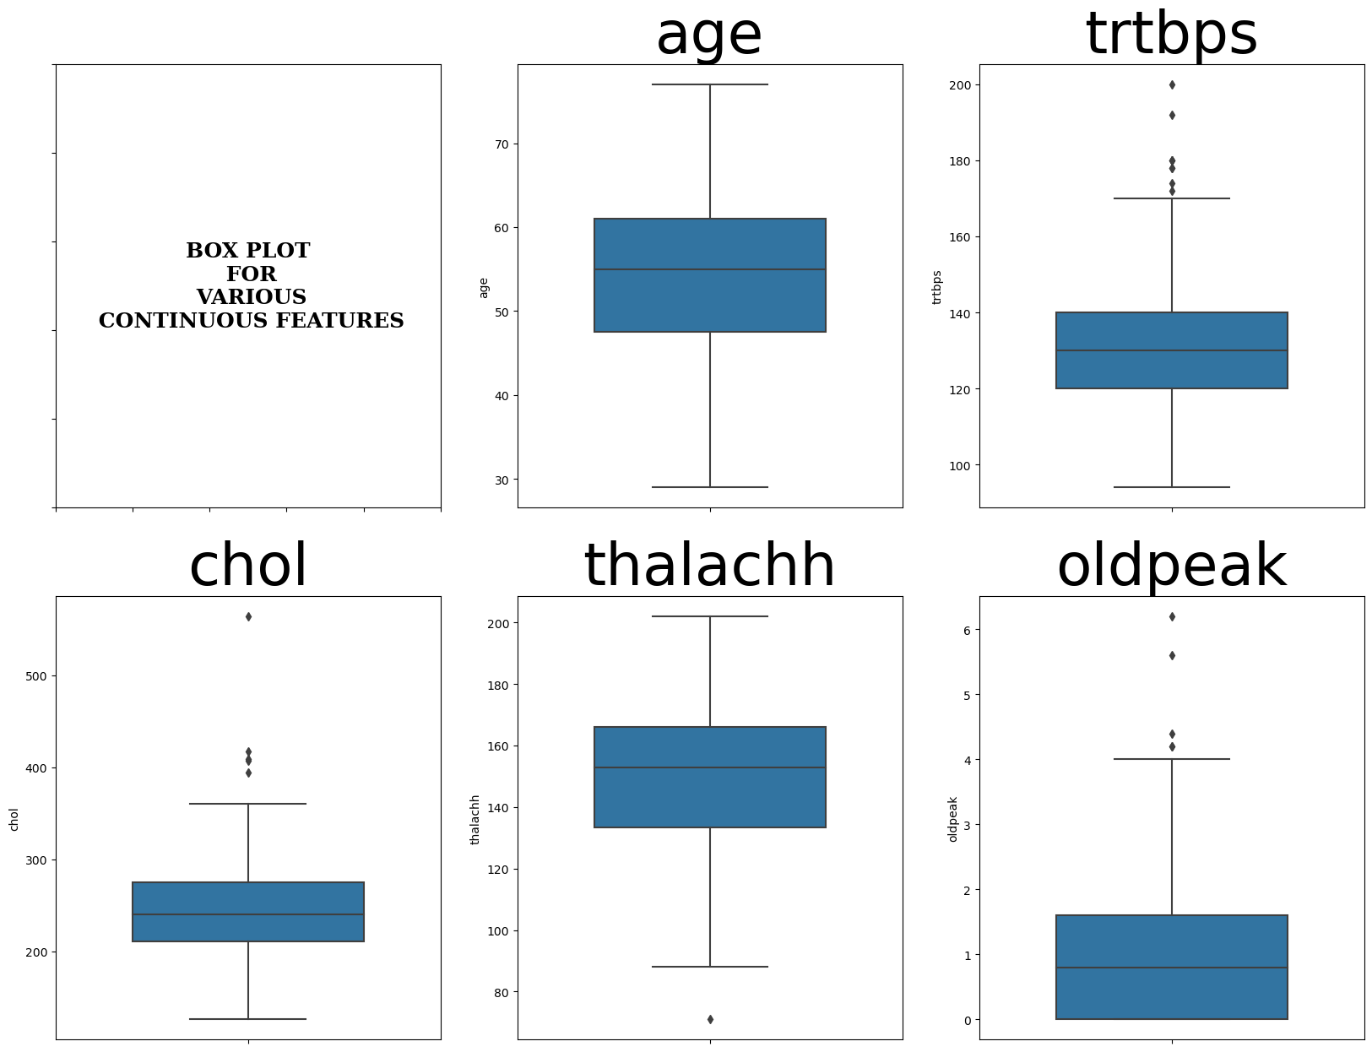

Slide 7
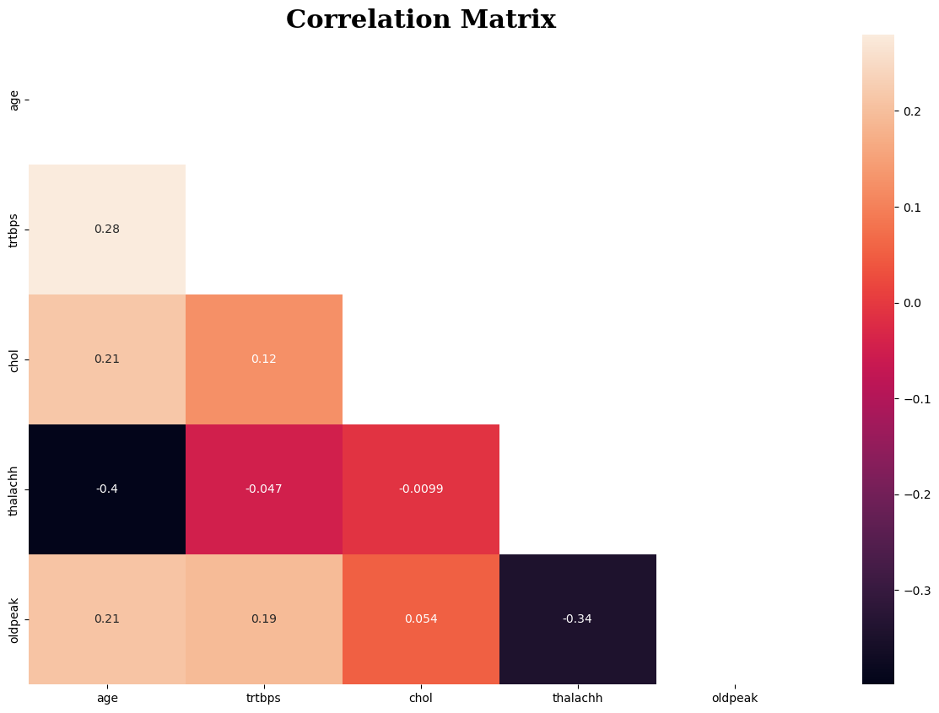

Slide 8
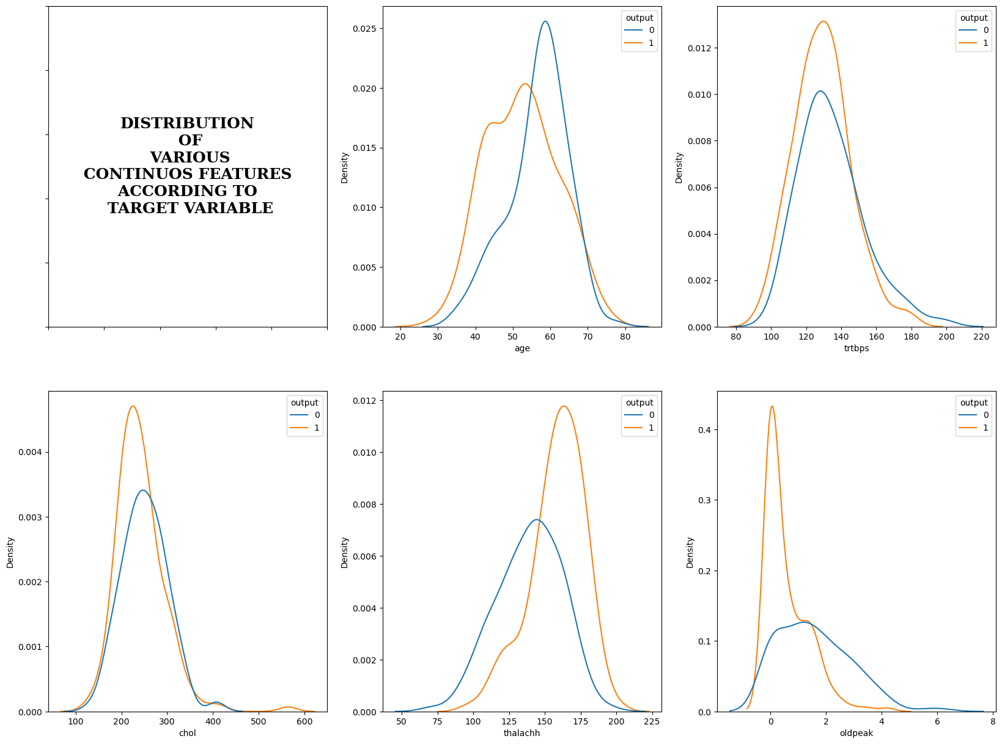

Slide 9
Key points
Data contains twice the number of people with sex = 1 than sex = 0
More data available with fasting_blood_sugar <= 120 mg/dl
33% people have exercise induced angina (pain in the chest that comes on with exercise)
There is no linear correlation between continuous variable according to the heatmap
As per the general observations in our day-to-day life, as the age increases there is more chances of heart attack, but it isn't the case according to the data.
According to data, there are more chances of attack if the cholestoral is between 200-300 mg/dl.
People with lower pevious peak achieved have higher chances of heart attack.
People with maximum heart rate achieved above 150 have higher chances of heart attack.

Slide 10
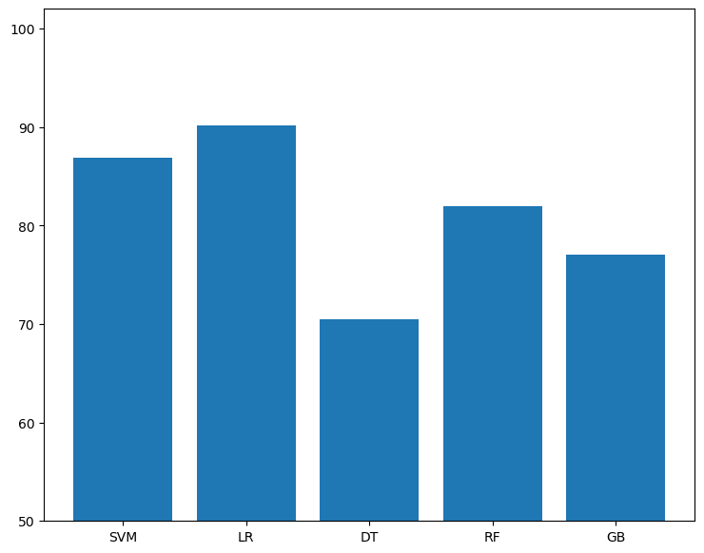
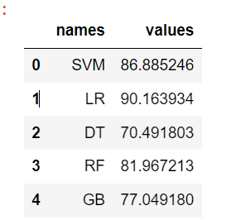
Predictive Model
Build model using various algorithms.
Logistic Regression algorithm gives good Accuracy.
Final model is build using Logistic Regression algorithm.

